Slide 1
Cognitive Status Use Case Scenario (example)
Pacio project

Slide 2
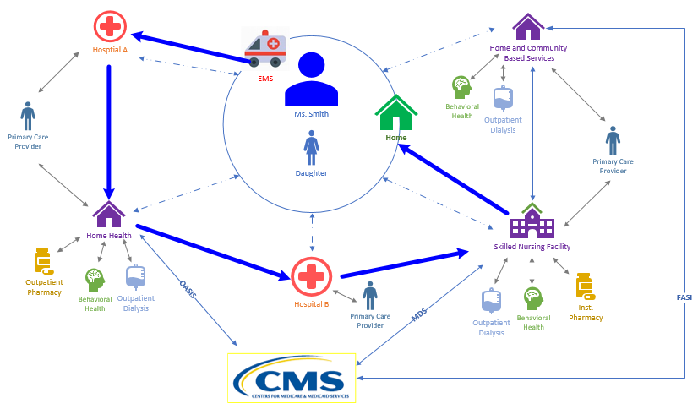
The Patient Story
Transfer
Summary
Transfer
Summary
Transfer
Summary
Transfer
Summary

Slide 3
Patient
Ms. Smith and her perspective

Slide 4
Social History
Ms. Smith is a 68 year old white female widow
Retired 3 years ago
Moved from Maryland to Texas.
Prior to her retirement, she worked as a receptionist in a hotel lobby
Depends on her social security check as her primary source on income
Patient lives alone
Patient is Alert and Oriented x 3
Remains independent in her Activities of Daily Living (ADLs)
Functionally independent with a cane
Drives her own car to get to medical appointments
Increasingly reliant on friends to drive her, due to intermittent dyspnea and blurry vision in her right eye
She has two children, a son and a daughter, who still reside in Maryland
Daughter works as an accountant, is married and has children
Son lives alone and works as a lawyer
Communication is poor between family members and Ms. Smith rarely discusses her healthcare with them

Slide 5
Medical History
PAST MEDICAL HISTORY
Patient leads a sedentary lifestyle and follows a poor diet with little exercise, which is a result of low health literacy, poor social support and multiple comorbidities. Patient has also started to experience frequent falls due to the osteoarthritis of the right hip. Patient was diagnosed with the following while she was in Maryland:
• Hypertension • Depression
• Hyperlipidemia • Cataracts
• Stage 3 chronic kidney disease • Osteoarthritis
• Ischemic heart disease • Type 2 diabetes

Slide 6
Current Medications
Patient has a complex medication list, which contributes to poor adherence.
• Lisinopril 40mg twice a day • Glargine 24 units SQ nightly
• Atorvastatin 40mg nightly • Insulin 3 units with each meal
• Calcium 500mg daily • Sertraline 25mg nightly
• Vitamin D 800IU daily • Tylenol 650mg every 6 hours or as needed
• Furosemide 20mg daily
• Ferrous Sulfate 325mg three times a day prior to meals

Slide 7
Typical Healthcare Follow Up
Patient does follow up with the primary care physician (PCP) and nephrologist regularly, but other specialist follow up is often sporadic. The PCP has been central to the patient’s healthcare information management.
• PCP • Cardiologist
• Endocrinologist • Nephrologist
• Psychiatrist • Ophthalmologist
• Retail Pharmacy • Lab Services

Slide 8
Encounter with Hospital Providers
Ms. Smith has as a right hip replacement in the hospital and is assessed by multiple care providers
Throughout the hospital stay, patient’s cognition is assessed in different ways:
CAM (Confusion Assessment Method)
Mini Mental Exam
MOCA (Montreal Cognitive Assessment)
Standard orientation questions (what is your name? Where are you right now? What is the date?)
Notes:
https://www.parkinsons.va.gov/resources/MOCA-Test-English.pdf
http://www.foundationsgroup.net/files/126558935.pdf

Slide 9
Encounter with SNF Providers
Ms. Smith is transferred to a skilled nursing facility after she is discharged from the hospital
Throughout the SNF stay, patient had the following cognitive assessments
BIMS
PHQ9
CAM
Notes:
https://www.parkinsons.va.gov/resources/MOCA-Test-English.pdf
http://www.foundationsgroup.net/files/126558935.pdf

Slide 10
Different Types Cognitive Assessments in Healthcare
Assessment | Description | Link
CAM (Confusion Assessment Method) | Evaluates for the presence of delirium in the patient There are multiple variations of this instrument including the short Cam, CAM-S, CAM – ICU, 3D CAM, FAM- CAM Proposed as a SPADE in PAC | https://www.marcusinstituteforaging.org/research/aging-brain-center/confusion-assessment-method https://www.aacn.org/docs/EventPlanning/WB0016/Delirium-CAM-ICU-gwgqydl2.pdf
BIMS (Brief Interview for Mental Status) | A snapshot into how well you are functioning cognitively at the time of the assessment Proposed as a SPADE in PAC | http://www.foundationsgroup.net/files/126558935.pdf
MOCA (Montreal Cognitive Assessment) | Screening test to assist health professionals in the detection of mild cognitive impairment and Alzheimer’s disease | https://www.parkinsons.va.gov/resources/MOCA-Test-English.pdf
MMSE (Mini Mental State Exam) | Tests cognitive function in the elderly (orientation, attention, memory, language and visual-spatial skills) | https://www.dhs.state.mn.us/main/idcplg?IdcService=GET_FILE&RevisionSelectionMethod=LatestReleased&noSaveAs=1&Rendition=Primary&allowInterrupt=1&dDocName=dhs16_159601
PHQ (Patient Health Questionnaire) | Assesses depression (both screens) There are variations of this assessment (PHQ-2, PHQ-9) Proposed as a SPADE in PAC | https://www.integration.samhsa.gov/images/res/PHQ%20-%20Questions.pdf

Slide 11
Different Types Cognitive Assessments in Healthcare
Assessment | Description | Link
Mini Cog Test | Screening for Cognitive Impairment in Older Adults | https://mini-cog.com/
St Louis University Mental Status Exam (SLUMS) | Screens for dementia Sometimes referred to as Mild Cognitive Impairment (MCI) or mild neurocognitive disorder (MNCD) | http://aging.slu.edu/pdfsurveys/mentalstatus.pdf http://medschool.slu.edu/agingsuccessfully/pdfsurveys/slumsexam_05.pdf https://www.verywellhealth.com/the-saint-louis-university-mental-status-examination-98618

Slide 12
Considerations
Outpatient/ ambulatory, acute and post acute care cognitive assessments are not captured and documented the same way
Post acute care has proposed cognitive status (BIMS, PHQ9 and CAM) as a standardized cognitive assessment (IMPACT Act mandated Standardized Patient Assessment Data Element (SPADE))

Slide 13
Ms. Smith’s Concerns
Concerns
What will my quality of life be? (Will I be independent in ADLs if my cognitive status changes?)
How will I maintain my health once I am at home (Will I remember to take my medications if my cognitive status changes?)

Slide 14
Ms. Smith would like…
To be able to recall and communicate her medical information (history of altered mental status) to all her providers as well as track her progress
To provide access to her children regarding her cognitive status, particularly during times when it is impaired

Slide 15
Daughter
The perspective from the patient’s daughter

Slide 16
Daughters Concerns
Concerns
How can I support Mom if she doesn’t communicate all of her healthcare information to me?
Will the providers know to contact and discuss Mom’s condition & progress with me?
Will Mom be able to manage her own healthcare needs (transportation to appointments, manage medications) once she leaves the SNF?

Slide 17
Daughter Would Like…
To have easy access to her Mother’s medical information in the event her mother is incapacitated
To be notified if her Mother’s cognitive status changes

Slide 18
Case Manager/ Social Worker (CM/ SW)
Care coordination perspective (hospital and SNF)

Slide 19
CM/ SW Concerns
Concerns
If patient is cognitively impaired, is it reversible? (e.g. stroke, delirium from a UTI)
What is patient's cognitive trajectory?
Will the SNF have the correct information about Ms. Smith’s cognitive status (e.g. delirium) and communicate progress toward goals, to the family?
Since Ms. Smith has limited social support, will family be able to support Ms. Smith once she is home or will patient need home care services?
What is the patients baseline cognitive status?

Slide 20
CM/ SW would like…
To be able to identify whether the patient has cognitive impairments in the EHR and, if so, to access the patient’s social support system quickly and efficiently
To be able to send information surrounding patient's cognitive status to other healthcare providers with minimal clicks

Slide 21
Provider Persona
Hospital and SNF Provider perspective

Slide 22
Hospital Provider Concerns
Concerns
If patient is cognitively impaired, is it reversible? (e.g. stroke, delirium from a UTI)
What is the patient’s cognitive trajectory?
Will Post Acute Care (PAC) have the correct information about the surgery, activity restrictions, and medication list?
Since Ms. Smith has limited social support, will she be able to follow medical orders and take medications as prescribed (especially if she is cognitively impaired?)
What is the patients baseline cognitive status?

Slide 23
SNF Provider Concerns
Concerns
If patient is cognitively impaired, is it reversible? (e.g. stroke, delirium from a UTI)
What is the patient’s cognitive trajectory?
Will the family have the correct information about the surgery, activity restrictions, and medication list?
Since Ms. Smith has limited social support, will she be able to follow medical orders and take medications as prescribed (especially if she is cognitively impaired?)
What is the patients baseline cognitive status?

Slide 24
Provider would like…
To be able to identify whether the patient has goals in the EHR from other healthcare settings, and if so to access the patient’s goals quickly and efficiently
To be able to send cognitive status and social support information to other healthcare providers with minimal clicks.

Slide 25
Payor
The payor perspective

Slide 26
Payor Concerns
Concerns
Do members have the right PAC services set up?
Will PAC have the correct information about the surgery, activity restrictions, and medication lists, social support system to give the best, most efficient care?
Do providers know what the members baseline cognitive status is?
Does the treatment plan maximize cost efficiency?

Slide 27
Payor would like…
To engage members in their healthcare and goals

Slide 28
Next Steps
Examine what is currently available that addresses cognitive status (FHIR or a C-CDA data model)
Identify any gaps in the available data model
Fill in gaps and build a FHIR Implementation Guide (IG)

Slide 29
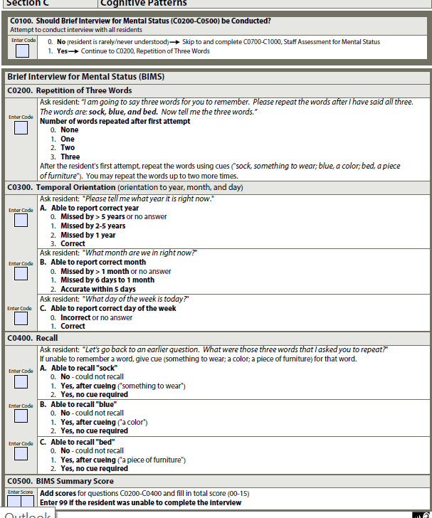
BIMS in the MDS

Slide 30
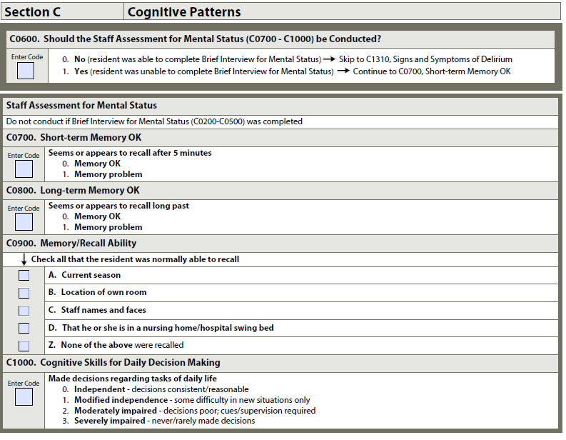
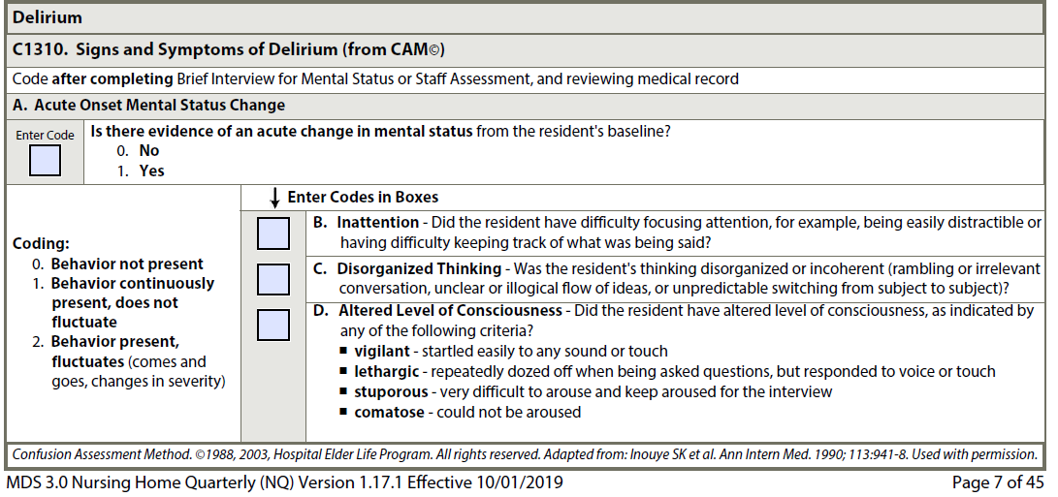
Mental Status and CAM in the MDS

Slide 31
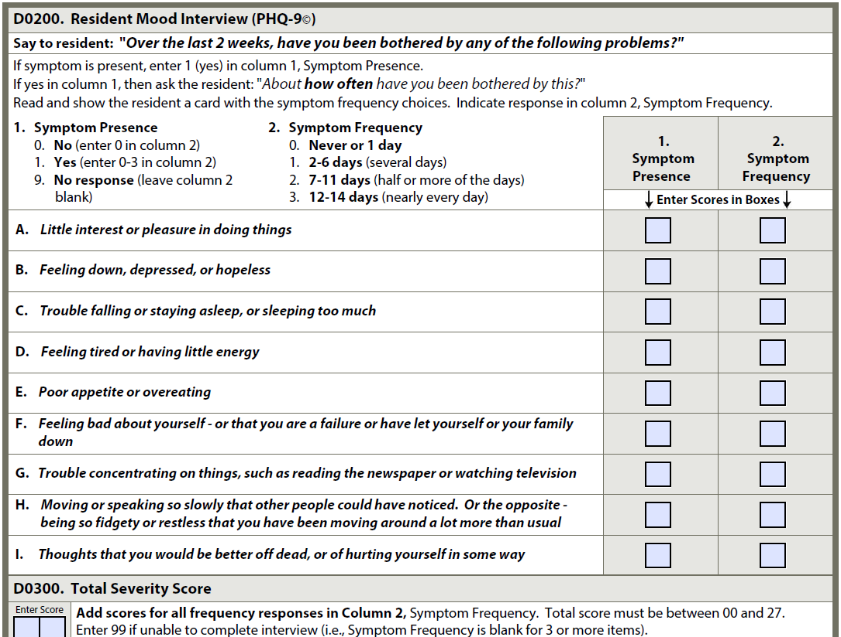
PHQ-9 in the MDS

Slide 32
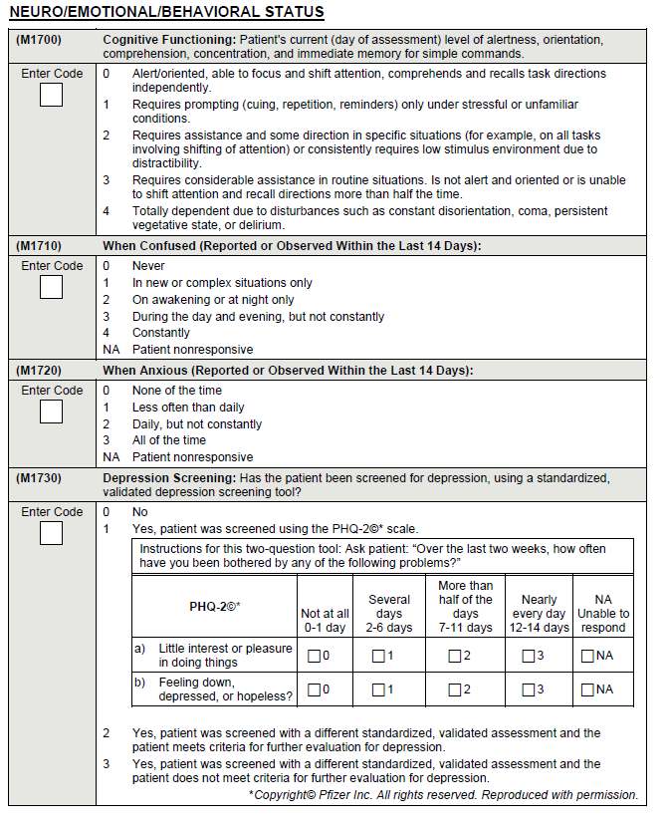
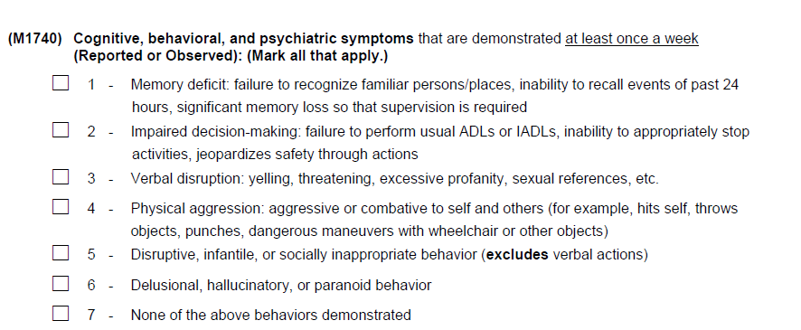
Cognition in OASIS D

